Slide 1

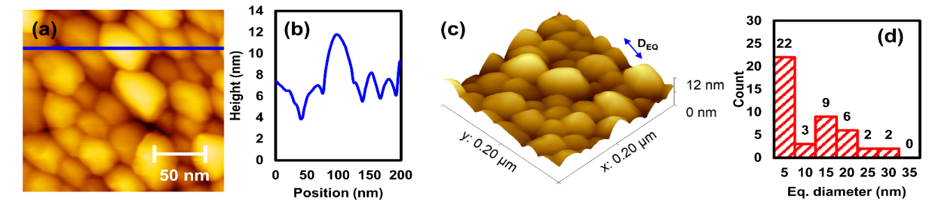
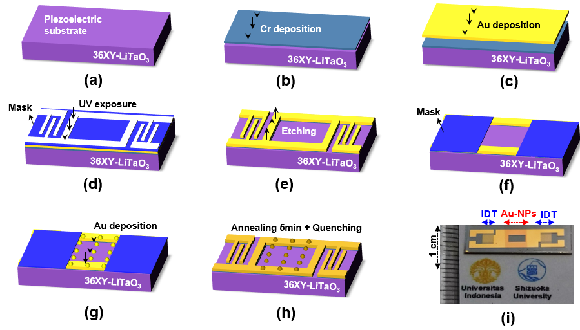
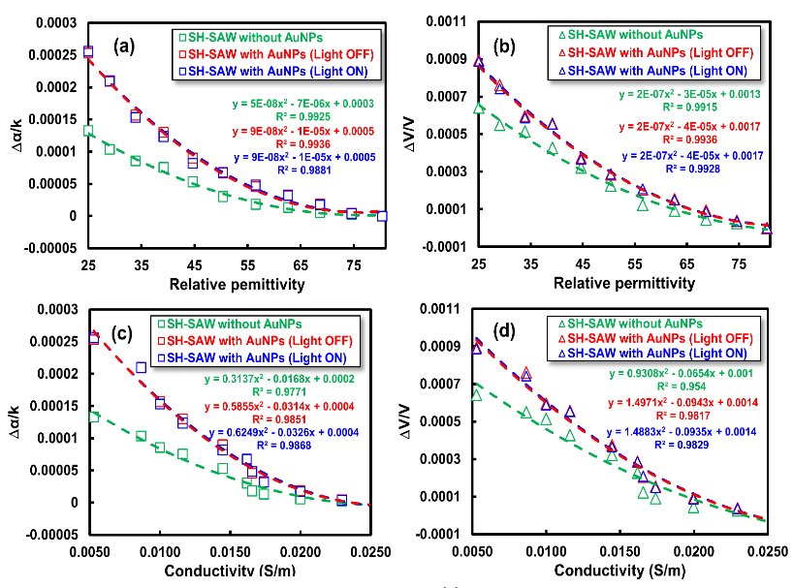
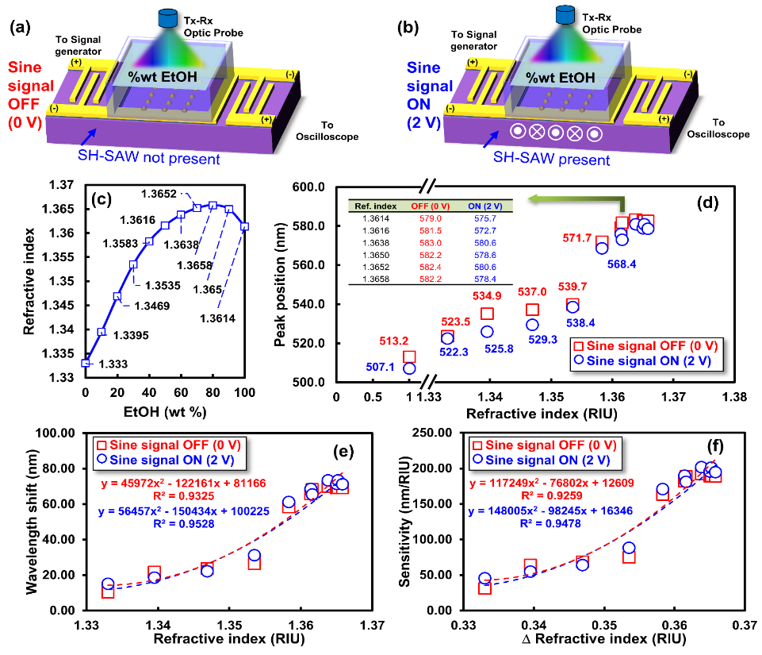
Integrated shear-horizontal surface acoustic waves with gold nanoparticles for multifunctional acousto-plasmonic liquid sensors fabricated on 36XY-LiTaO₃
3. Result and discussion
Teguh Firmansyah^{1,2}, Gunawan Wibisono², Eko Tjipto Rahardjo², Jun Kondoh¹
¹Shizuoka University and ²Universitas Indonesia
1. Introduction
Shear-horizontal surface acoustic wave (SH-SAW) device has excellent performance at electrical properties response with optimum frequency. The detection mechanisms of SH-SAW are based on the change of field distributions of particle displacements and electric potential [1]-[2]. Besides that, the SH-SAW sensor can integrate with the wireless system [3]. Moreover, the localized surface plasmon resonance (LSPR) sensor based on gold nanoparticles has advantages at optical side performance, such as robust against bulk refractive index changes, vibration or mechanical noise, easy to manufactured with affordable price, and small size because no needed prims [4].
As a novelty, I proposed the integration between SH-SAW and LSPR effect technology to develop multifunctional sensors on a common substrate, as shown in Fig 1. Therefore, the sensor has simultaneous detection, not only based-on electrical properties but also with optical response
10.1021/acsami.1c00110
Figure 3. a), (b), (c), and (d) depict the captured 2D AFM image with a size of 200 nm × 200 nm, the height of AuNPs at the line, the 3D surface of the AFM image, and the particle distribution, respectively. [5]
Z
Figure 1. Integrated liquid sensor based on LSPR and SH-SAW devices using 36YX-LiTaO₃ substrate
Figure 2. Fabrication procedure [5]
10.1021/acsami.1c00110
2. Fabrication and experimental procedure
The SH-SAW was fabricated on a 36YX-LiTaO₃ substrate, as shown in Fig. 1. The SH-SAW device has op en and short propagation surfaces between the input and interdigital trans-ducers (IDTs). The gold nanoparticles (AuNPs) should be deposited to the center of SH-SAW propagation surfaces to integrate with the LSPR sensor, as shown in Fig 2. The Au wire about 5.4 ± 0.1 mg (Tokuriki Hon-ten Co. Ltd., Japan) was used to evapo-rate gold thin film. During the deposi- tion process, the IDT should be covered. After that, to make AuNPs, the sample was annealed with 400 ˚C for 5 minutes.The vector network analyzer (VNA HP 4395A) was used to investigate the electrical response. Furthermore, the op-tical reflection data response was taken by USB4000 UV-Vis spectro-photometer (Ocean Optics, Inc., USA), and data were collected using Opwave + software.
10.1021/acsami.1c00110
Figure 4. (a), (b) Details of Δα/k₀ and ΔV/V­ for different εr values; (c), (d) details of Δα/k₀ and ΔV/V­ for different σ value, respectively; (e) proposed time-domain measurement; and (f) comparison of the T_{a} values of the SH-SAW sensor without AuNPs and SH-SAW sensor with AuNPs. (e) Correlation between the n value and Δλ. (f) S_{r} of the LSPR sensor for the OFF and ON sine signals. [5]
References
S. Okuda, et al., ACS Sens. 3, pp. 200−204 (2018).
K. Takayanagi, et al., Jpn. J. Appl. Phys. 57, 07LD02. (2018).
A. Pohl, IEEE Trans. UFFC 47, pp. 317-332 (2000).
E. Kazuma, et al., Nanoscale 6, pp. 2397-2405 (2014).
T.Firmansyah, ACS. Appl. Mat Int, 13 (2021), pp. 13822-13837

