Slide 1
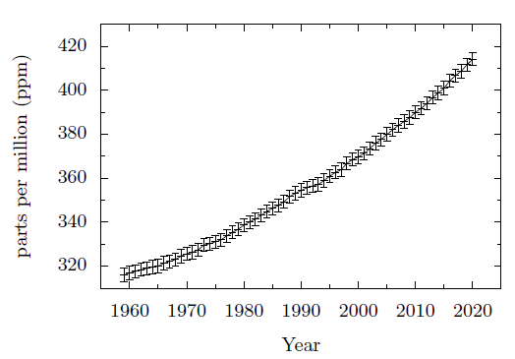
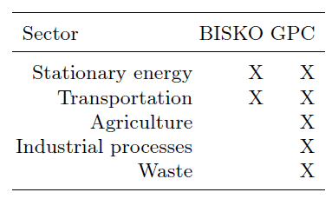
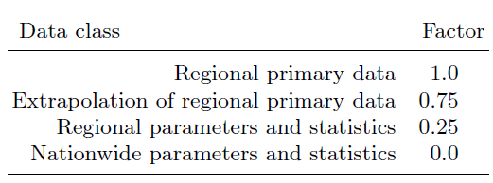
Comparison and choice of the greenhouse gas accounting method for a model region in Germany
Tatiana N. Fedosenko-Becker (1), Michael Becker (2), and Michael Berger (1)
1 Institute for the Transformation of the Energy System (ITE), West Coast University of Applied Sciences,
e-mail: fedosenko-becker@fh-westkueste.de
2 Eco.income engineering GmbH, e-mail: michael@ecoincome.world
The problem of climate change is getting more serious from year to year.
Fig. 1. Atmospheric CO2 at Mauna Loa Observatory from 1959 to 2020. The data shows an increase of CO2 concentration in the atmosphere of almost 31%. www.gml.noaa.gov/ccgg/trends/
The German federal government has set the central goals of reducing greenhouse gas emissions by at least 80% by 2050 compared to 1990 and providing 60% of gross final energy consumption from the renewable energies by 2050.
Energy system decarbonization should take place in the following sectors: stationary, transport, agriculture, waste.
The development of roadmaps up to complete CO2-neutrality in a model region is one of the tasks of the German project "WESTKUESTE100".
Chosen accounting methods for the model region (Schleswig-Holstein in Germany): BISKO (accounting system for municipalities) and the GPC (Greenhouse Gas Protocol).
Table 1. Consideration of different sectors from BISKO and GPC:
Table 2. Definition of the factors for the data quality based on the BISKO method:
Based on these factors, the final data quality can be calculated by:
(1)
where G is the value of the data quality, E is the share in the greenhouse gas balance, F is the factor determined and i is the number of the sector.
Conclusions
The accounting methods follow different approaches when considering individual sectors, as well as when applying the 'polluter pays' principle or territorial principle within the individual sectors. A uniform and thus comparable accounting methodology is of course indispensable for the definition of applicable scenarios.

